Slide 1
MN: Environmental and health conditions compared to poverty
Group 1
November 20, 2023
Eric Johnson, Paul Moses, Waynei Mebrahtu, Mitchell Lor, Lucinda Hodgson

Slide 2
General hypothesis
There will be higher levels of pollutants, and higher incidence of certain health issues in MN counties where there are more households living under the poverty line.
Decided to focus on the ones with the most complete data for the largest time span: arsenic, heart attack and cancer

Slide 3
Design
Look at 10 years of public data from MN
Census Bureau, MN Department of Health, Center for Disease Control
Sort by county and poverty rate
Test the data for a correlation between poverty and chosen variable
Consider looking at counties, rural/urban and state level
Merged our chosen metrics with census data by county
Analyzed each set

Slide 4

Data sources
MN department of health: https://www.health.state.mn.us/data/index.html
US Census: https://www.census.gov/data/developers/data-sets.html
CDC: https://data.cdc.gov/

Slide 5
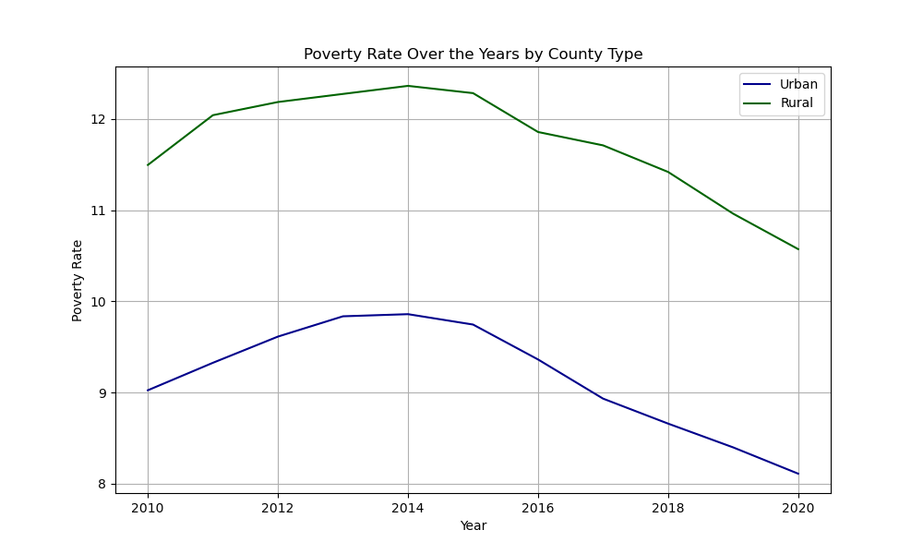
Poverty in MN
The poverty rate= ratio of the number of people (in a given age group) whose income falls below the poverty line
2022 8.6% MN
Better that national rate (11.5%)
disparities
13.7 % northwest region
3.8% Washington County
10.2% MN over age 65
Chart, poverty/time

Slide 6
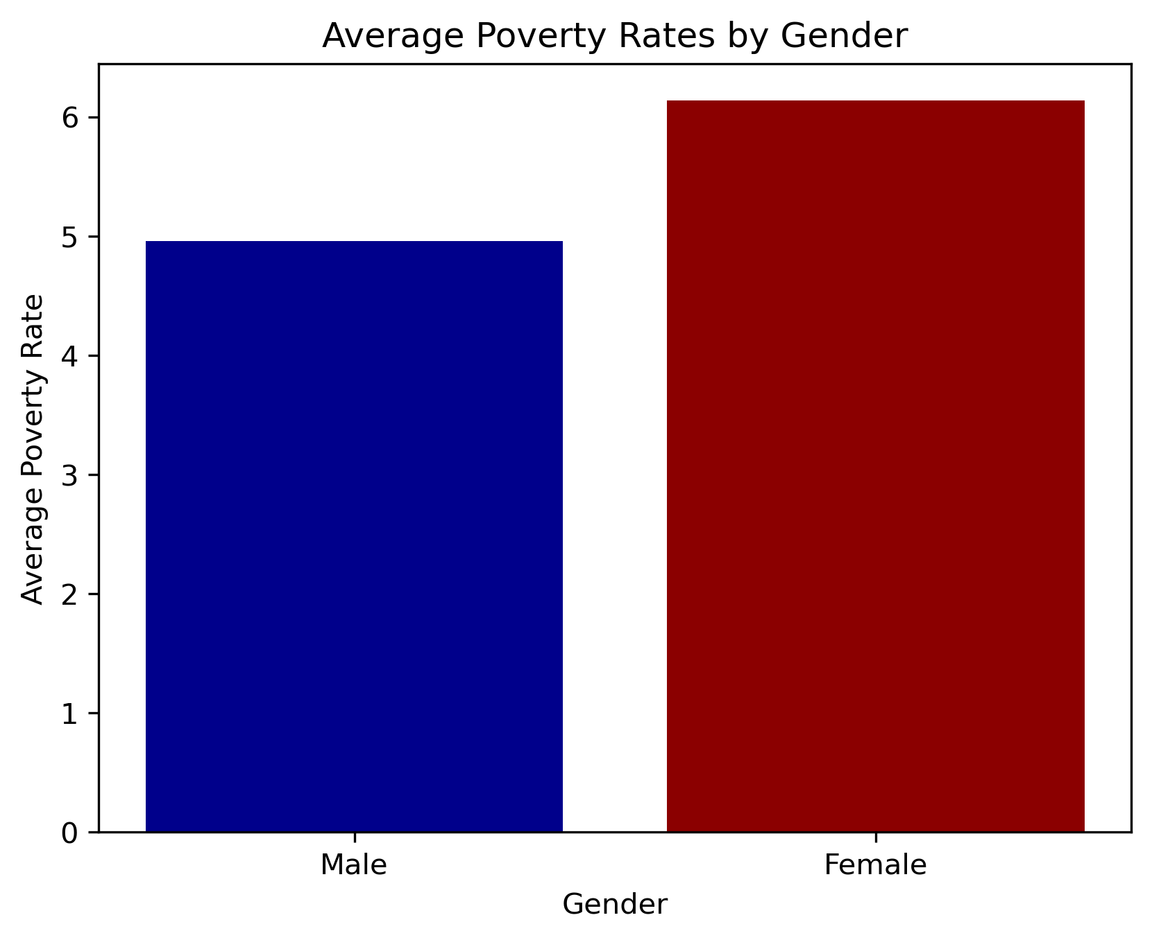
Average Poverty Rates by Gender, MN, all years

Slide 7
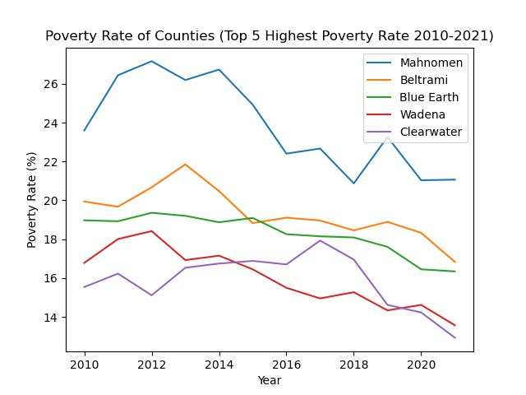
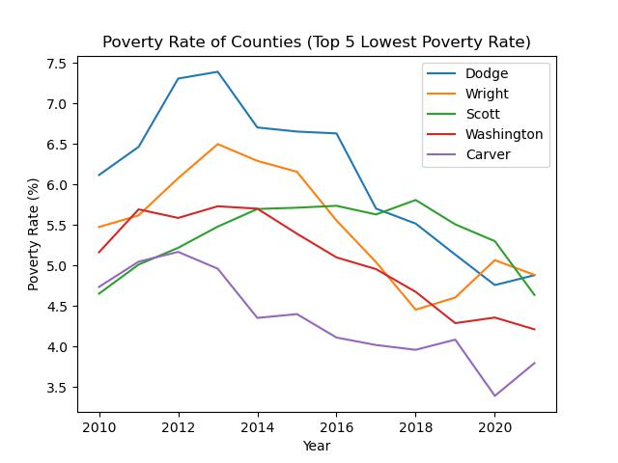
Lowest and highest counties by year

Slide 8
Arsenic and poverty:
Specific hypothesis:
Arsenic levels will be higher in counties with higher poverty rates, as measured by groundwater levels over 10 years.

Slide 9
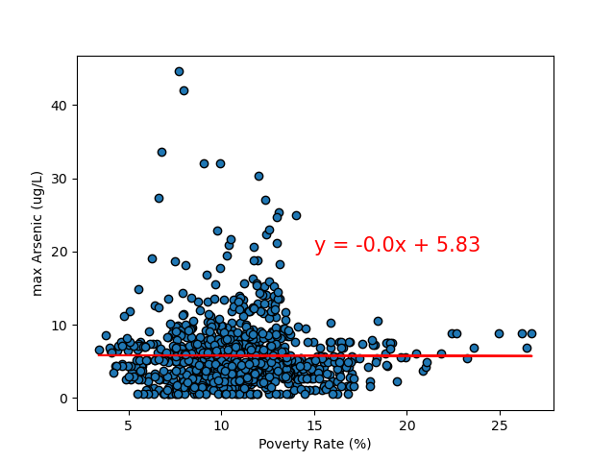
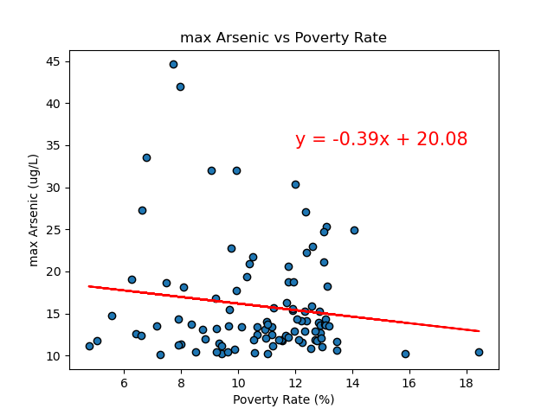
Max Arsenic level(ug/L) v Poverty Rate(%)
All counties (all years)
Top 5 highest poverty rate counties (all years)
All counties: max Arsenic vs Poverty Rate

Slide 10
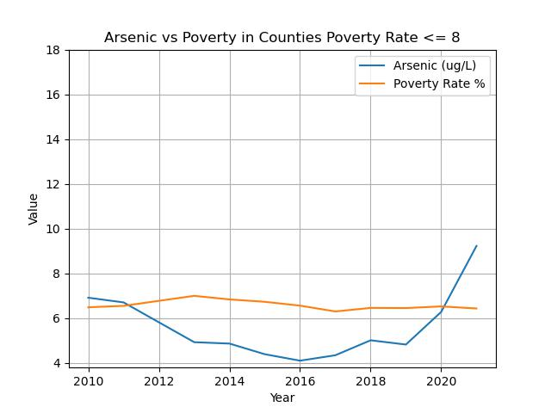
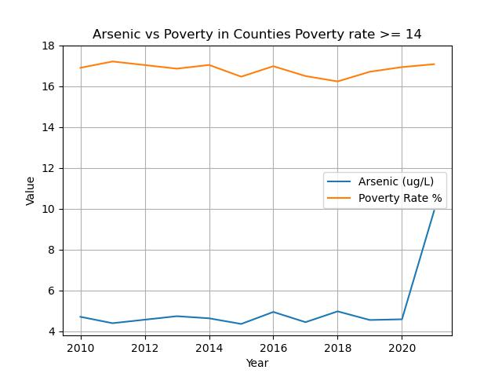
Arsenic v poverty rate (<=8% or >=14%)

Slide 11
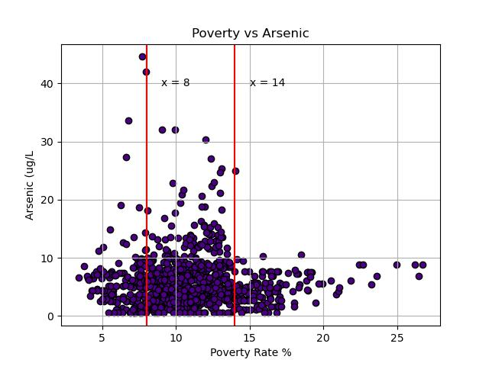
Max Arsenic Vs Poverty Rate

Slide 12
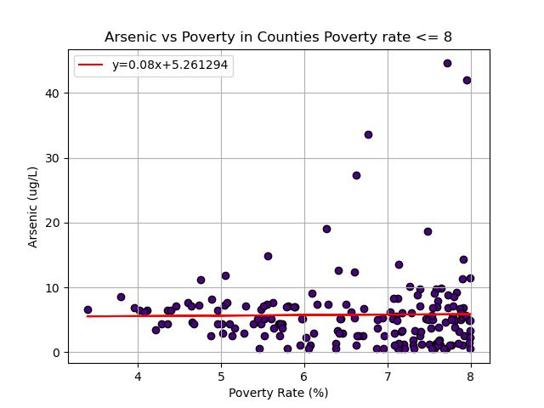
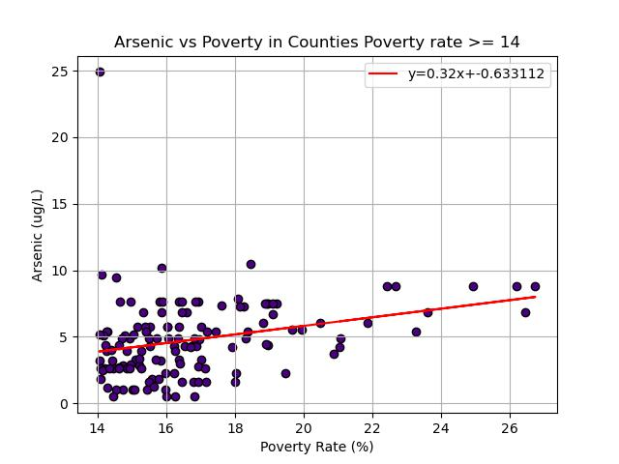
Low Poverty Vs High Poverty

Slide 13
Heart Attack
Specific hypothesis
Heart attack rates will be higher with elevated poverty rates.

Slide 14
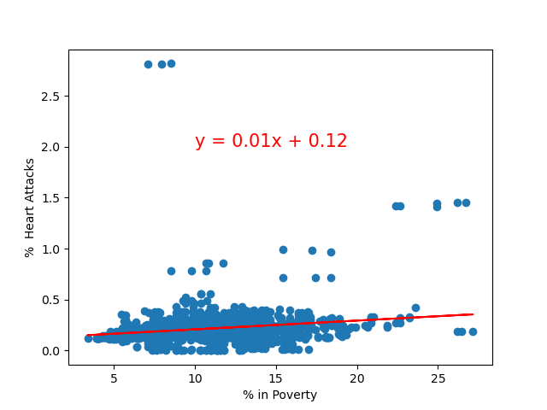
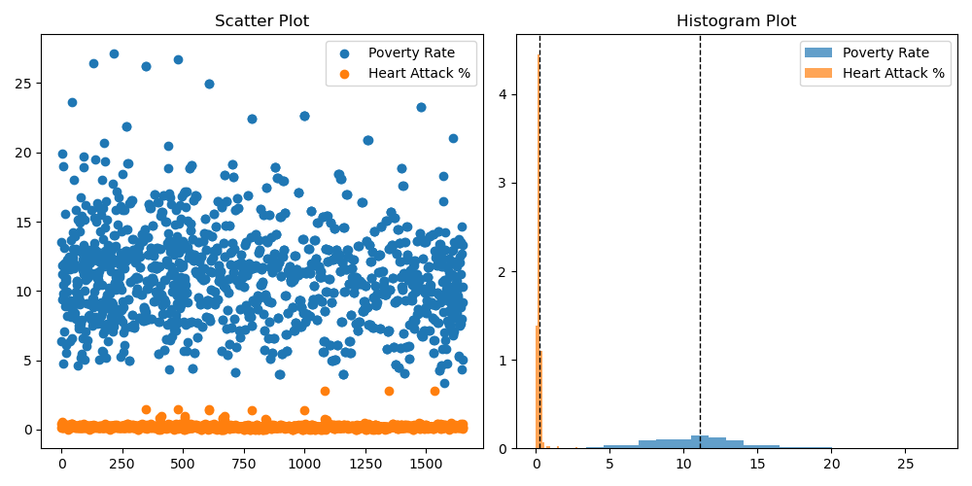
Linear Regression and T-tests
Linear Regression, Poverty v Heart attack

Slide 15
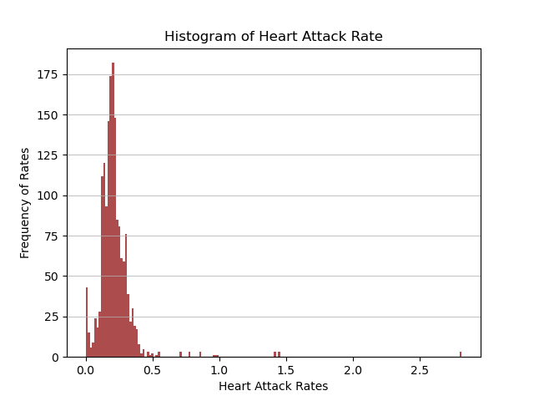
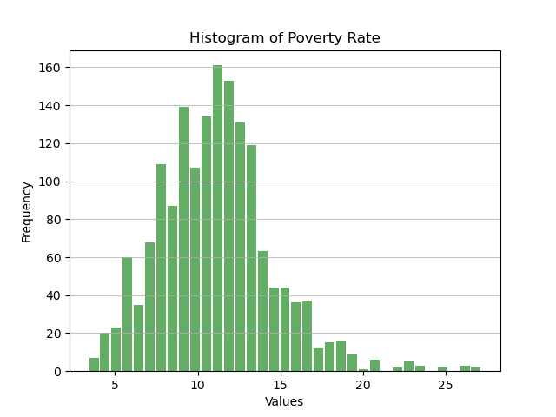
Histograms: Heart Attack and Poverty Rate

Slide 16
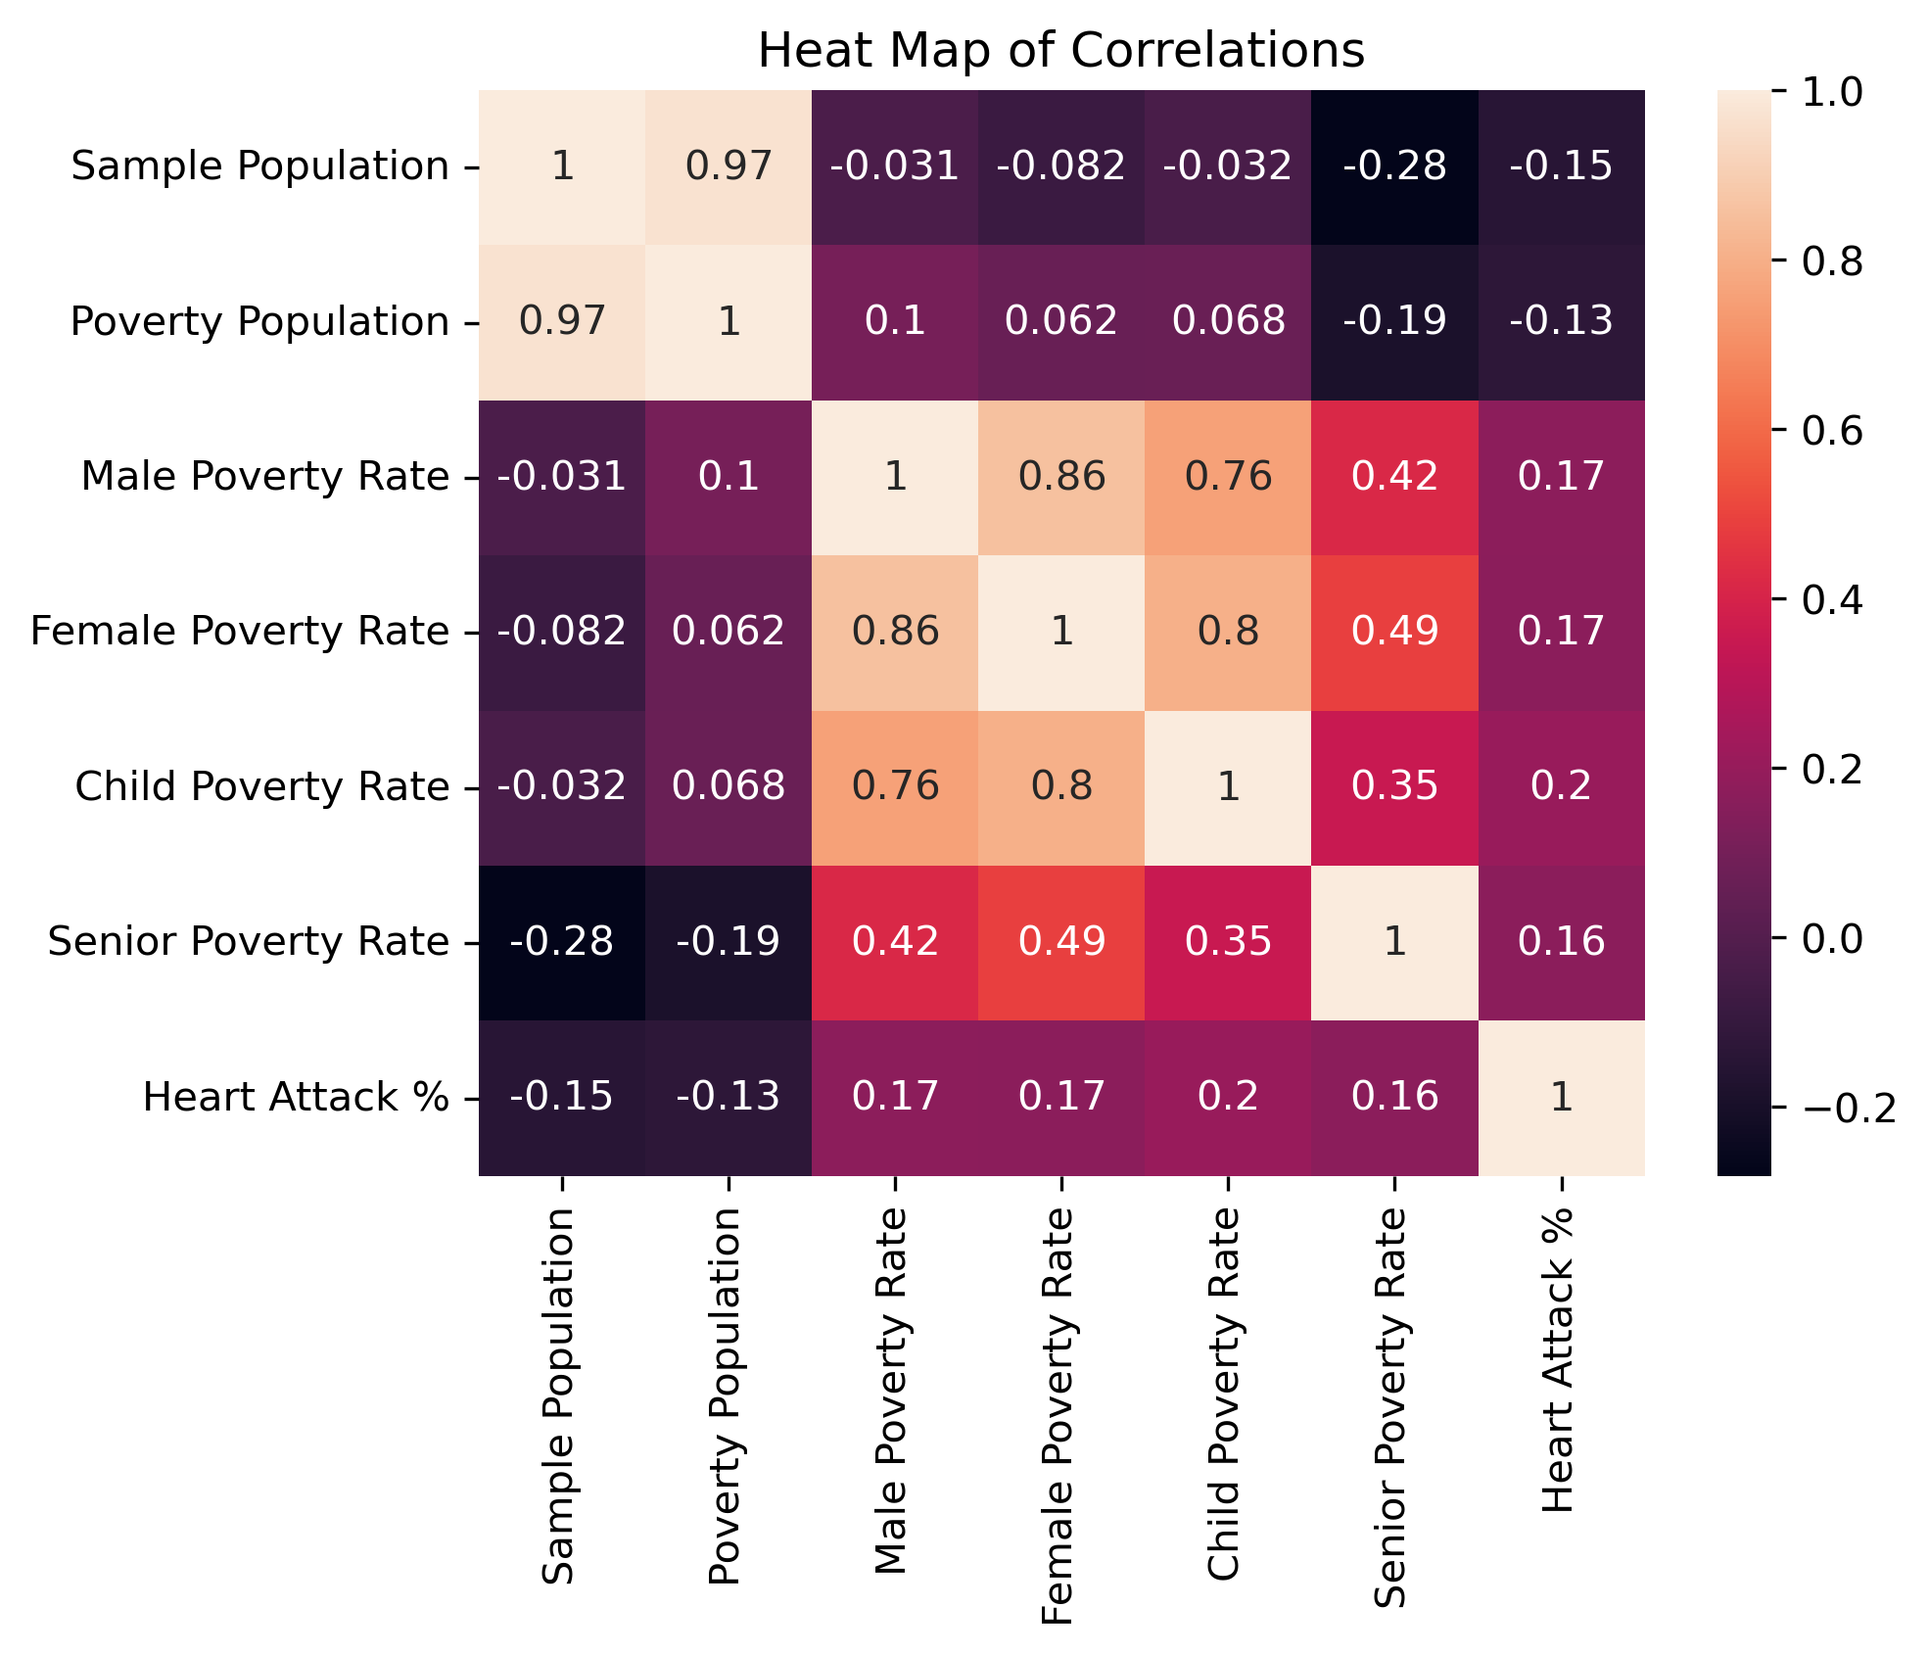
Heart Conclusion

Slide 17
Cancer and poverty
Specific hypothesis
Cancer levels will be higher in counties with higher poverty rates.

Slide 18
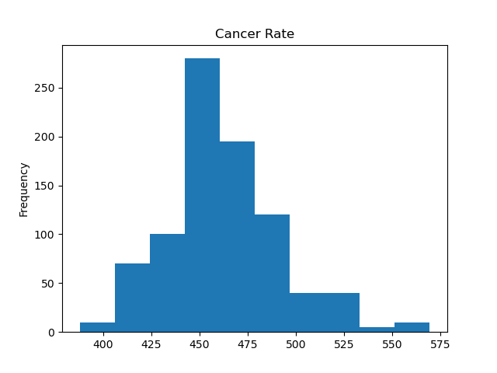
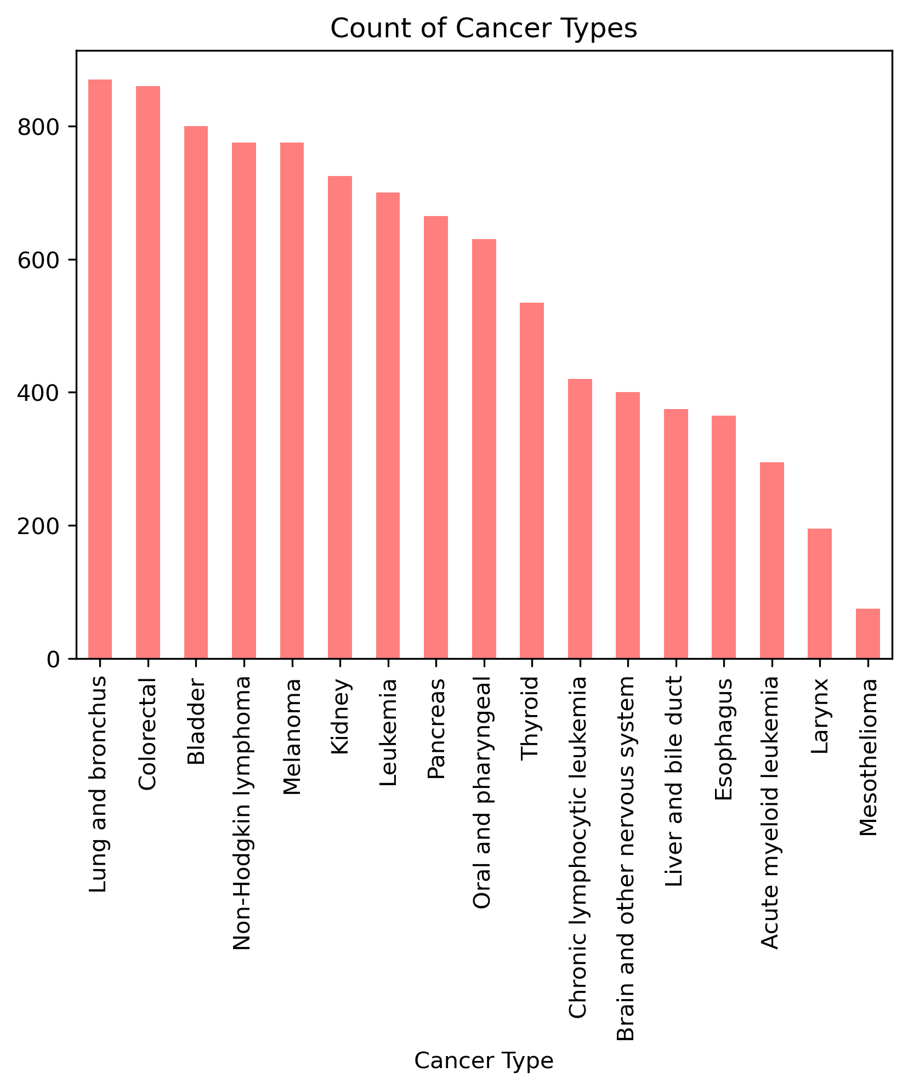
Cancer

Slide 19
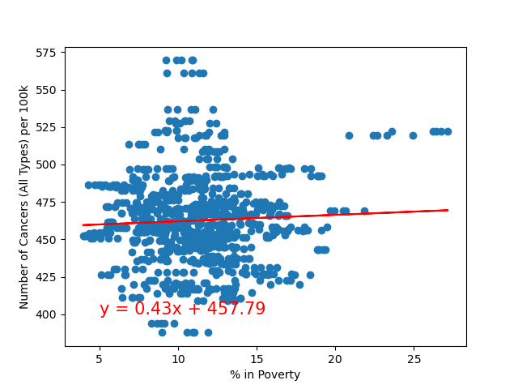
cancer
cancer rate v poverty rate

Slide 20
Conclusion /
limitations
Our data showed no obvious correlation between poverty and the variables we chose
Our results suggest further study or more granular data is needed as we know in at least one category there is a known correlation
County data likely too broad for looking at poverty
Census tract data might be a better source
End point revision (cancer deaths as opposed to incidence)

Slide 21
Resources
Arsenic:
https://www.fda.gov/food/environmental-contaminants-food/arsenic-food-and-dietary-supplements#:~:text=To%20reduce%20health%20risks%20associated,for%20bottled%20water%20as%20well.
https://www.ncbi.nlm.nih.gov/pmc/articles/PMC4186553/
https://www.niehs.nih.gov/health/topics/agents/arsenic/index.cfm#:~:text=Arsenic%20levels%20tend%20to%20be,of%20arsenic%20in%20certain%20locations.
Poverty Level:
https://www.irp.wisc.edu/resources/how-is-poverty-measured/#:~:text=Poverty%20is%20measured%20in%20the,in%20charge%20of%20measuring%20poverty.
https://www.census.gov/topics/income-poverty/poverty/guidance/poverty-measures.html
https://www.hhh.umn.edu/news/minnesota-poverty-report-finds-income-disparities-persist-minnesota
https://www.census.gov/topics/income-poverty/poverty/guidance/poverty-measures.html
Heart Attack:
https://www.fda.gov/food/environmental-contaminants-food/arsenic-food-and-dietary- supplements#:~:text=To%20reduce%20health%20risks%20associated,for%20bottled%20water%20as%20well.
Cancer:
https://www.cancer.gov/about-cancer/understanding/what-is-cancer#:~:text=Cancer%20is%20a%20disease%20caused,are%20also%20called%20genetic%20changes.
https://www.ncbi.nlm.nih.gov/pmc/articles/PMC6291807/#:~:text=Both%20work%20stress%20and%20financial,with%20minimal%20or%20no%20stress.

